Slide 1
Shared Class Notebook
Vincent Mac and Nicholas Chin
CSE 111-01, Professor Rusu

Slide 2
System Description
Database that allows students and their professors to add, update, and view each others notes within their respective classes.
Using a standard SQLite3 database and accessing the database with Python
Human interaction with python code is conducted through terminal

Slide 3
Implementation Details
Integrated Development Environment (IDE)
Microsoft Visual Studio Code
Database
SQLite3 Database
Language
SQLite3
Python

Slide 4
Important Use Cases
Students
Accessing note folders for your classes made by your professor or peers
Ability to see folders of all of your registered classes
View, upload, edit notes from your peers or professor
Request to join a different class
See who is in your classes

Slide 5
Important Use Cases
Professor
Ability to upload and edit class notes or documents for viewing
Act as the administrator for their class database
View/Accept requests to Join class
View Classes they Teach
View Class roster

Slide 6
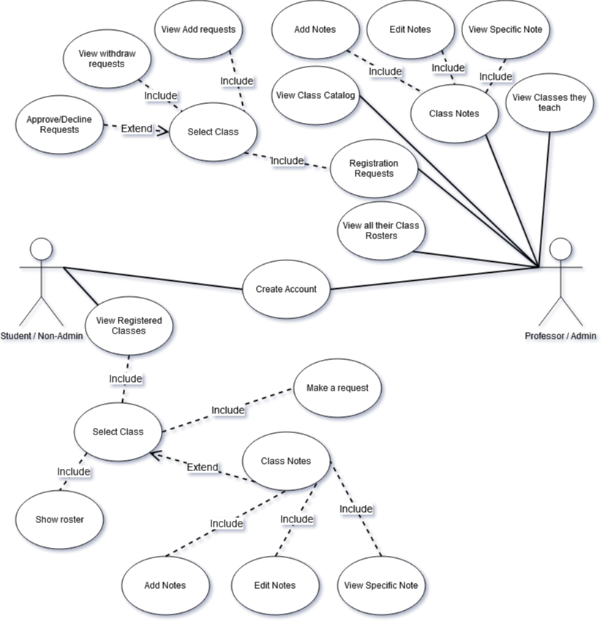
Use Case Diagram

Slide 7
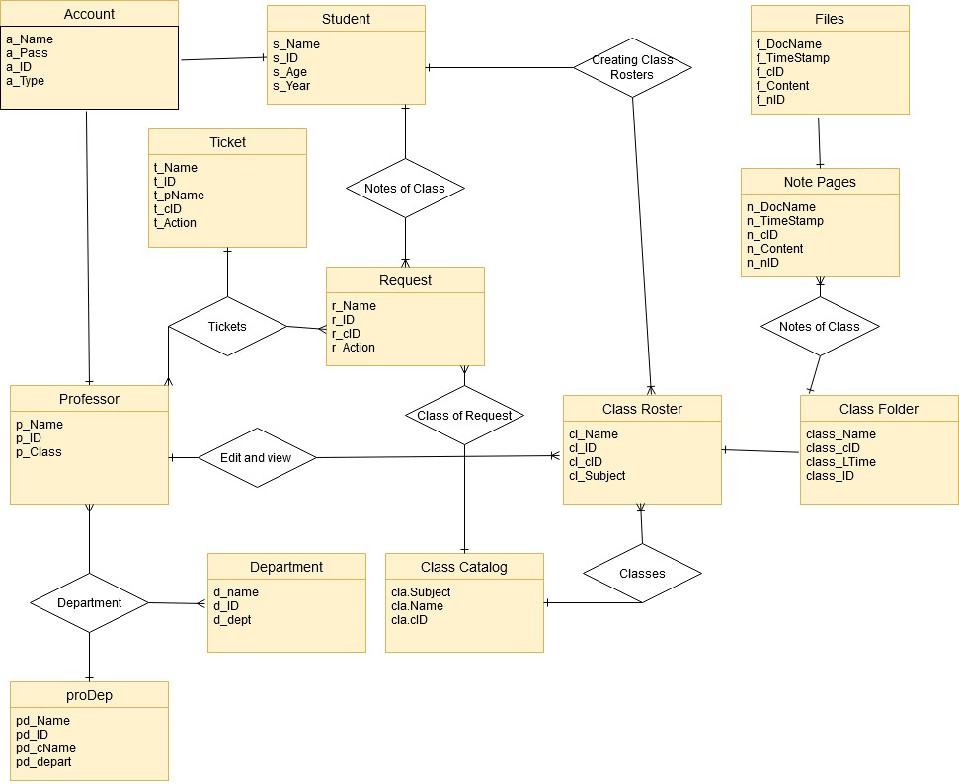
E/R Diagram

Slide 8
Relational Schema
NOTE PAGES
n_docName varchar(50)
n_timeStamp text
n_cID Unsigned int
n_content text
CLASSES REGISTERED
reg_cName varchar(50)
reg_cID Unsigned int
reg_ID Unsigned int
CLASS FOLDER
class_name varchar(50)
class_cID Unsigned int
class_LTime text
files
n_docName varchar(50)
n_timeStamp text
n_cID Unsigned int
n_content text
STUDENT
s_name varchar(50)
s_ID Unsigned int
s_age Unsigned int
s_year Unsigned int
Account
a_name varchar(50)
A_pass varchar(5)
a_ID int
a_type varchar(50)
Ticket
t_Name varchar(50)
t_ID int
t_cID int
t_pName varchar(50)
R_action varchar(50)
t_pID Int
Request
r_Name varchar(50)
r_ID int
r_cID int
r_pName varchar(50)
R_action varchar(50)
PROFESSOR
p_name varchar(50)
p_ID Unsigned int
P_cID Unsigned int
CLASS CATALOG
cla_name varchar(50)
cla_cID Unsigned int
CLASS ROSTER
Cl_name varchar(50)
cl_ID Unsigned int
cl_cID Unsigned int
department
d_name varchar(50)
d_ID int
d_dept varchar(50)

